Slide 1


Slide 2

Major Project (01CE0716)
Semester 7
Viva & Submission (22/08/2026)
QR Code Phishing Detection System (Quishing Detection)
Team ID: 7P_121
Team Member 1: Yash Talaviya (92410103105) (7EC3)
Team Member 2: Tirth Bhut (92410103093) (7EC3)
Team Member 3: Pratham Gajra (92410103106) (7EC3)
Guided By
Internal Guide
Prof. Yogeshwar Prajapati (Assistant Professor)
Department of Computer Engineering, Faculty of Engineering & Technology

Slide 3
Outline
Abstract
Summary Remarks of Review 1 & 2
Introduction
How Attack Works
Problem Statement
Literature Review
Dataset Details
Methodology & Flowchart
Tools & Technologies Used
Model Result & Confusion Matrix
Conclusion
Future Scope
References

Slide 4
Abstract
The “QR Code Phishing Detection System (Quishing Detection)” is designed to identify and prevent malicious QR codes that redirect users to fraudulent or phishing websites. With the increasing use of QR codes in digital payments, advertisements, and authentication systems, cybercriminals exploit them to steal sensitive information such as banking credentials and personal data. The proposed system analyzes QR code URLs, domain reputation, redirection behavior, and suspicious patterns using cybersecurity and intelligent detection techniques. The framework can warn users before accessing harmful links and help reduce phishing attacks. The project aims to improve user safety, strengthen digital trust, and provide secure QR code scanning mechanisms.

Slide 5
Summary Remarks of Reviews
Remarks and Suggestions Given by Reviewers (Review 1):
Suggested to Write and Publish the Research Paper in a Journal.
We Have Done:
Written the research paper. and We will submit the research paper.
Suggestions Given by Reviewers (Review 2):
Submit the Research Paper.
We Have Done:
We have Submitted IPR in MU

Slide 6
Introduction to Domain – Cyber Security
Cyber Security is the practice of protecting computers, networks, applications, and data from cyber threats and unauthorized access.
It ensures the Confidentiality, Integrity, and Availability (CIA) of digital information. With the growth of online services, attacks such as Phishing, Malware, Ransomware, and Identity Theft have become more common.
Cybersecurity techniques help detect, prevent, and respond to these threats.

Slide 7
Introduction to Sub-Domain – Quishing Detection
Quishing (QR Code Phishing) is a phishing attack that uses malicious QR codes to redirect users to fake or harmful websites.
Users cannot verify the destination of a QR code before scanning it.
Traditional security systems often fail to detect malicious URLs hidden inside QR code images.
Quishing Detection combines image analysis and URL analysis to identify phishing QR codes.
A Hybrid Detection Approach improves accuracy and provides better protection against Quishing attacks.

Slide 8
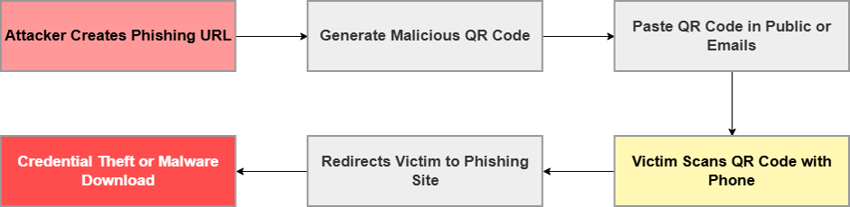
How Attack Works

Slide 9
How Attack Works
Link Creation: The attacker sets up a fake website (phishing page).
QR Code Generation: The attacker converts the malicious link into a QR code.
Distribution: The attacker prints and sticks it on public areas (like parking meters, public tables) or sends it via phishing emails.
User Action: The victim scans the QR code, bypassing email filters.
Exploitation: The victim is redirected to the fake site, leading to credential theft or malware download.

Slide 10
Problem Statement
QR codes cannot be read by humans, so users cannot know whether the link is safe or malicious before scanning.
Traditional security systems mainly check text, emails, and attachments, but they often fail to detect malicious links hidden inside QR code images.
Attackers use shortened or redirected URLs to hide the real destination, making it difficult to identify phishing websites by checking the URL alone.
As QR code usage is increasing in payments, advertisements, and login systems, there is a need for an accurate and reliable system that can detect phishing QR codes before users become victims.

Slide 11
Literature Review
Ref | Author & Year | Detection Technique | QR Code Analysis Method | Features Used | AI/ML Model | Dataset Source | Research Gap
[1] | Yalda et al., 2026 | Blockchain authentication | Cryptographic chaining | Cryptographic hash, metadata, QR ID | Cryptographic | Custom Simulated Blockchain | Traditional systems lack real-time revocation and have shared key vulnerabilities.
[2] | Rafsanjani et al., 2026 | Static feature classification | URL lexical & host analysis | Blacklist, lexical, host, content features | Heuristic rule-based | URLhaus, PhishTank | ML models are data-dependent; excessive app permissions compromise privacy.
[3] | Nejati et al., 2026 | Hybrid (Image & URL) | CNN & Lexical analysis | Spatial patterns, URL tokens | CNN, LLMs, RF, XGBoost | PhishStorm, MalwareBazaar, PhishTank | Lack of comprehensive multi-format datasets covering diverse attachment types.
[4] | Ozuberk & Cinar, 2026 | Image-based | CNN & ML on QR images | Grayscale histogram, LBP, GLCM | DenseNet121, LightGBM, RF | Mendeley Data (1000 images) | Need for URL-independent threat detection combined with explainable AI.
[5] | Trad & Chehab, 2026 | Image-based (QR-centric) | Structural & pixel analysis | Raw QR code pixels | XGBoost, LightGBM, RF, DT | Derived from PhishStorm | URL extraction inherently exposes users to potential malicious payloads.

Slide 12
Literature Review
Ref | Author & Year | Detection Technique | QR Code Analysis Method | Features Used | AI/ML Model | Dataset Source | Research Gap
[6] | Akram et al., 2026 | Structural feature analysis | Binary grid recovery | Finder, alignment, separators, timing | Pre-trained classification model | Custom synthetic dataset | Existing visual/URL methods fail on QR codes.
[7] | Akram et al., 2025 | Structural feature analysis | Protocol-level & statistical | Version, ECC, module count, density | Random Forest, XGBoost | Custom Feat-DataSet-1 & 2 | Deep learning models act as black boxes lacking interpretability and transparency.
[8] | Ahmed et al., 2025 | Systematic review of URL-based, image-based | URL lexical | URL data tokens | Pre-trained classification model | URL Dataset | Disjointed paradigms; lack of scalable, user-friendly real-world security solutions.
[9] | Nigam & Bhandari, 2025 | URL Based Analysis | Lexical analysis | Cryptographic methods | XGBoost | Kaggle | Need for robust systems combining human awareness
[10] | Bhumika K S et al., 2025 | Hybrid (ML + Heuristic) | Decoded text analysis | TF-IDF, URL length, suspicious keywords | XGBoost + Heuristic Engine | Not Reported | Consumer apps decode QR contents without verifying URL properties

Slide 13
Literature Review
Ref | Author & Year | Detection Technique | QR Code Analysis Method | Features Used | AI/ML Model | Dataset Source | Research Gap
[11] | Osari et al., 2025 | Machine Learning URL detection | URL extraction & analysis | URL length, subdomains, HTTPS, suspicious terms | Gradient Boosting, Neural Networks | Labeled dataset of genuine/malicious URLs | Existing mitigation strategies ignore human behavioral elements and user awareness.
[12] | Sarkhi & Mishra, 2024 | ML Classification | Image classification | Visual image patterns | Lightweight DL Model | 651,xxx samples | Low recall specifically for malware classification.
[13] | Vaithilingam & Shankar, 2024 | NLP & Image Processing | Text/Semantic analysis | Textual and semantic features | NLP AI | Small datasets | High computational overhead on mobile devices.
[14] | Sharevski et al., 2024 | Naturalistic user study | Lexical Analysis | URL data tokens | RF,DT | n=42 participants | Small sample size limits behavioral generalizability.
[15] | Ford & Berry, 2024 | Image Recognition | Embedded email image detection | Pixel/image data | CNNs | 200,000 images | High computational demand for high-throughput environments.

Slide 14
Literature Review
Ref | Author & Year | Detection Technique | QR Code Analysis Method | Features Used | AI/ML Model | Dataset Source | Research Gap
[16] | Bhagwani et al., 2024 | API Threat Analysis | Real-time URL scanning | URL reputation/blacklist | API-based | API-based real-time data | Reliance on external APIs causes latency.
[17] | Galadima et al., 2024 | Systematic Review | Decoded Text Analysis | Raw QR code pixels | Pre-trained classiffication Model | Review paper | Lacks empirical testing and novel technical frameworks.
[18] | Ahmer Khalique Khan, 2023 | Heuristic techniques (lexical and host-based) | URL extraction to Phish-Score algorithm | 19 lexical and host-based features | Heuristic algorithm | Curated list of mixed URLs | Existing apps lack user choice and compromise privacy.
[19] | Dhanraj S. et al., 2023 | Machine learning and deep learning | FIND FROM URLS | URL structure, IP addresses, regular expressions | DCNN, RNN, LSTM, ResNet50 | CSV files of URL records | Traditional blacklists fail against zero-day malicious URLs.
[20] | Betty Herlina & Haryono Soeparno, 2023 | Machine learning classification | URL Lexical analysis | 17 features (URL length, IP, domain age, etc.) | XGBoost, RF, DT, SVM, MLP, Autoencoder | Dynamic database via wget | Human failure in QR phishing needs high-accuracy models.

Slide 15
Dataset Details
Dataset Size: 200,000 QR codes Image Based (Kaggle)
Legitimate (Benign): 100,000 QR codes.
Phishing (Malicious): 100,000 QR codes.
The QR code images that belong to malicious URLs are under the 'malicious' folder with 'malicious' word in their file name. On the other hand, the QR cods that belongs to benign URLs are listed under 'benign' folder with 'benign' word appears in their filename.
Purpose: Used to train machine learning models to detect phishing/spam QRs.

Slide 16
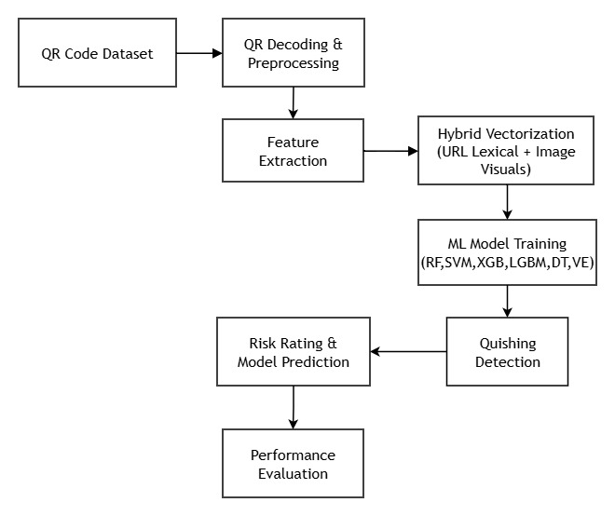
Proposed Methodology

Slide 17
Proposed Methodology
QR Code Dataset: Load the dataset containing both legitimate and phishing QR code images.
QR Decoding & Preprocessing: Decode QR codes to extract embedded URLs and preprocess the images for analysis.
Feature Extraction: Extract visual features from QR images and lexical features from the decoded URLs.
Hybrid Vectorization: Combine URL lexical features and QR image visual features into a single hybrid feature vector.
ML Model Training: Train and Test multiple machine learning models, including Random Forest, SVM, XGBoost, LightGBM, Decision Tree, and Voting Ensemble.
Quishing Detection: Use the trained models to classify QR codes as Safe or Phishing.
Risk Rating & Model Prediction: Generate the final prediction along with the corresponding risk level for each QR code.
Performance Evaluation: Evaluate the trained models using Accuracy, Precision, Recall, F1-Score, and Confusion Matrix to measure their performance.

Slide 18
Tools & Technologies Used
Programming Language: Python
Development Environment: Jupyter Notebook (IPython)
Image Processing: OpenCV (QR code decoding, preprocessing, edge detection, contour extraction)
Data Processing: Pandas, NumPy
Machine Learning: Scikit-Learn (preprocessing, feature scaling, Decision Tree, Random Forest, SVM (Linear), Voting Ensemble, evaluation metrics)
Gradient Boosting: XGBoost, LightGBM (high-performance classification)
Feature Extraction: Hybrid Features (QR image features + decoded URL features)
Visualization: Matplotlib, Seaborn (confusion matrix and performance graphs)
Dataset: QR Code Phishing Dataset (200,000 QR code images – Legitimate & Phishing)

Slide 19
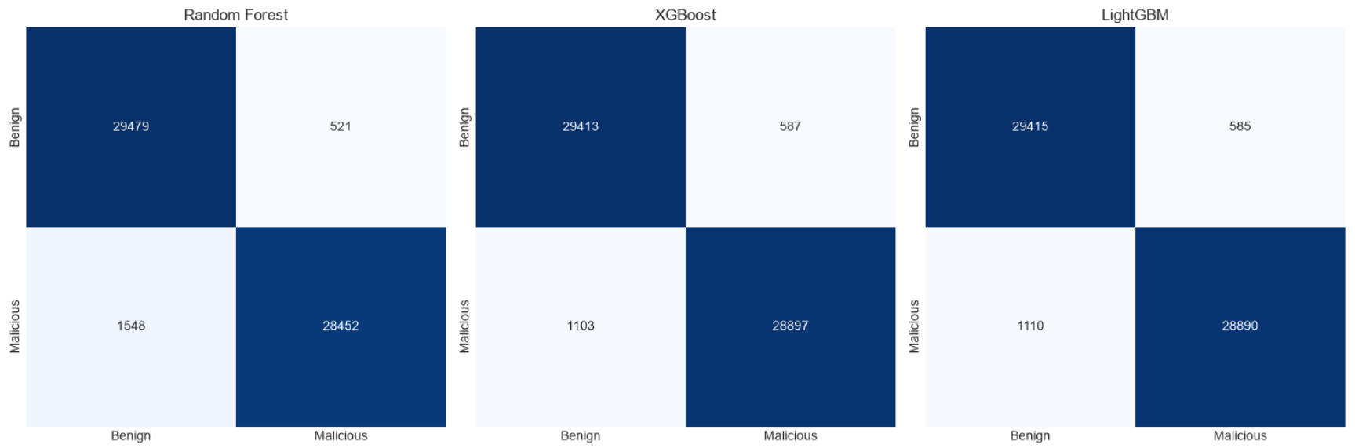
Model Result (Confusion Matrix)

Slide 20
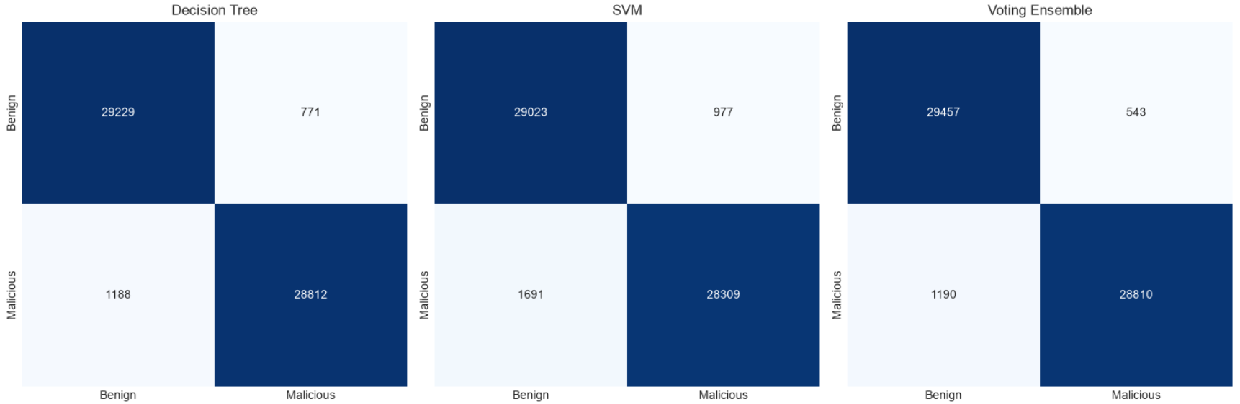
Model Result (Confusion Matrix)

Slide 21
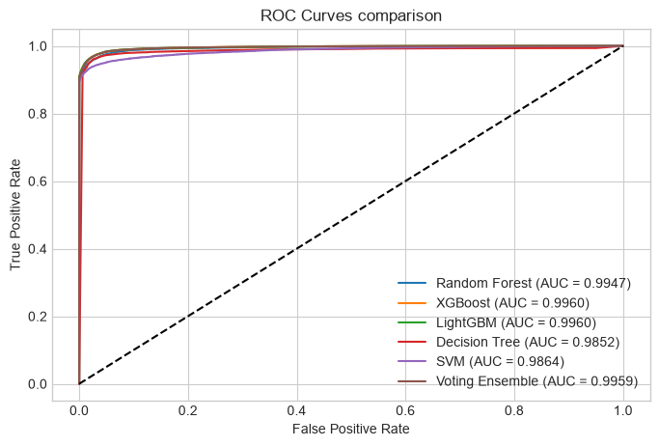
Model Result (ROC Curve)

Slide 22
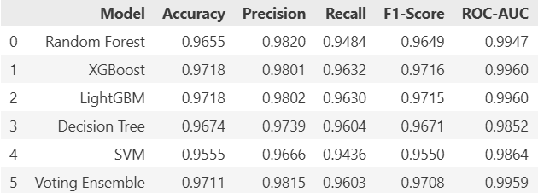
Model Result (Comparision Table)

Slide 23
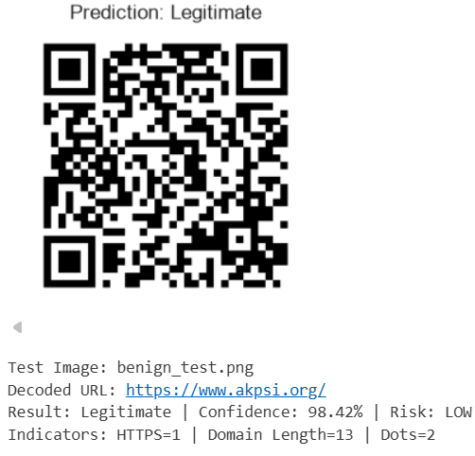
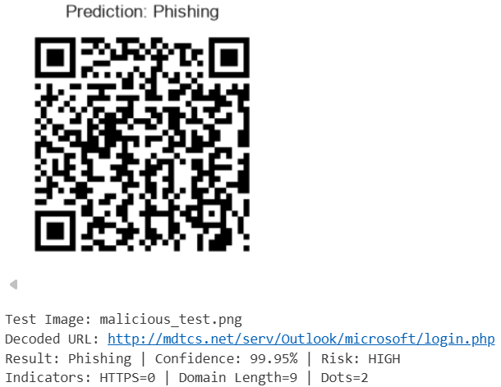
Model Result (Testing)

Slide 24
Existing Models VS Our Models
Autor Name | Accuracy
[10] Bhumika K S et al., 2025 | 93.40%
[2] Rafsanjani et al., 2026 | 93.50%
[5] Trad & Chehab, 2026 | 91.06%
Our Model | 97.18%

Slide 25
Conclusion
The proposed QR Code Phishing Detection System was successfully developed to accurately identify both legitimate and malicious QR codes. The system uses a hybrid feature extraction approach, combining QR code image features with decoded URL features, which significantly improves detection performance. Multiple machine learning algorithms, including Decision Tree, Random Forest, SVM, XGBoost, LightGBM, and Voting Ensemble, were trained and evaluated. Among these, XGBoost and LightGBM achieved the highest accuracy 97.18% and were selected as the final models for the system. Overall, the proposed approach provides an effective solution for detecting Quishing attacks and enhances user protection against phishing QR codes.

Slide 26
Future Scope
Prepare and submit the research paper to a national or international conference.
Optimize the model for faster prediction and better real-time performance.
Improve the model by incorporating and testing new phishing patterns and emerging attack techniques.
Test the model on more real-world QR code to improve its reliability.

Slide 27
References
[1] R. Yalda, A. Khan, and N. Nepal, "B-PhishQR—A blockchain-based framework for secure QR code verification against phishing attacks," Telematics and Informatics Reports, vol. 21, p. 100289, 2026, doi: 10.1016/j.teler.2025.100289.
[2] A. S. Rafsanjani, N. B. Kamaruddin, H. M. Rusli, and M. Dabbagh, "QsecR: Secure QR code Scanner According to a Novel Malicious URL Detection Framework," IEEE Access, vol. 11, pp. 92523-92539, 2023, doi: 10.1109/ACCESS.2023.3291811.
[3] F. Nejati, M. Rabbani, M. Eskandarian, M. Mirani, G. Piya, I. Opushnyev, A. A. Ghorbani, and S. Dadkhah, "CIC-Trap4Phish: A Unified Multi-Format Dataset for Phishing and Quishing Attachment Detection," arXiv preprint arXiv:2602.09015, 2026.
[4] M. A. Ozuberk and I. Cinar, "Malicious QR Code Classification Using Machine Learning, Deep Learning, and Explainable AI," in 2026 5th International Informatics and Software Engineering Conference (IISEC), 2026, pp. 1-6, doi: 10.1109/IISEC69317.2026.11418433.
[5] F. Trad and A. Chehab, "Detecting Quishing Attacks with Machine Learning Techniques Through QR Code Analysis," arXiv preprint arXiv:2505.03451, 2026.
[6] M. W. Akram, K. Sood, M. U. Hassan, and D. Thiruvady, "ALFA: A Safe-by-Design Approach to Mitigate Quishing Attacks Launched via Fancy QR Codes," arXiv preprint arXiv:2601.06768, 2026.

Slide 28
References
[7] M. W. Akram, K. Sood, and M. U. Hassan, "QRïS: A Preemptive Novel Method for Quishing Detection Through Structural Features of QR," arXiv preprint arXiv:2510.17175, 2025.
[8] F. Ahmed, I. Fatima, M. U. Hassan, I. Rasheed, and U. Fayyaz, "Malicious QR Code Detection: A Comprehensive Review of Methods and Challenges," Spectrum of Engineering Sciences, vol. 3, no. 12, pp. 1462-1472, 2025, doi: 10.5281/zenodo.18196524.
[9] N. Nigam and R. Bhandari, "Performance Analysis of QR Phishing Detection Approaches," Journal of Information Systems Engineering and Management, vol. 10, no. 335, pp. 221-225, 2025.
[10] B. K. S., R. B. Bhuvaneshwari, P. S. Pavan, H. S. Varun, and J. G. C., "AI Based QR Code Fraud Detection System," International Journal of Innovative Research in Science, Engineering and Technology (IJIRSET), vol. 14, no. 12, pp. 22809-22815, 2025, doi: 10.15680/IJIRSET.2025.1412039.
[11] R. Osari, K. K. Baraskar, G. Silakari, P. Jain, P. Jain, and P. Verma, "Design and Analysis of Machine learning based QR Phishing Detection System," International Journal of Advanced Research in Science, Communication and Technology (IJARSCT), vol. 5, no. 12, pp. 67-76, 2025, doi: 10.48175/IJARSCT-25909.
[12] M. Sarkhi and S. Mishra, "Detection of QR Code-based Cyberattacks using a Lightweight Deep Learning Model," Engineering, Technology & Applied Science Research, vol. 14, pp. 15209–15216, 2024.

Slide 29
References
[13] S. Vaithilingam and S. A. M. Shankar, "Enhancing Security in QR Code Technology Using AI: Exploration and Mitigation Strategies," International Journal of Intelligence Science, vol. 14, no. 2, pp. 49–57, 2024.
[14] F. Sharevski, M. Mossano, M. F. Veit, G. Schiefer, and M. Volkamer, "Exploring Phishing Threats through QR Codes in Naturalistic Settings," in Proceedings 2024 Symposium on Usable Security, 2024.
[15] J. Ford and H. S. Berry, "Feasibility of Machine Learning-Enhanced Detection for QR Code Images in Email-based Threats," 2024 Cyber Awareness and Research Symposium (CARS), Grand Forks, ND, USA, 2024, pp. 1-9, doi: 10.1109/CARS61786.2024.10778732
[16] M. K. Bhagwani, A. Gangwar, K. Vishwakarma, A. Khare, V. K. Tiwari, and A. Dubey, "Preventing Malware Spread through QR Codes: A Detection and Analysis Approach," J. Eng. Technol. Manage., vol. 73, pp. 1260-1268, Sep. 2024.
[17] S. A. Galadima, M. Shrivastava, and G. Sonowal, "QR Code Phishing: A Review of the Current Attacks and Countermeasures," JuniKhyat, vol. 14, no. 9, no. 3, pp. 1-6, Sep. 2024.
[18] K. A. Khalique, "Detecting Phishing URLs in QR codes using Heuristic Techniques," M.S. thesis, School of Computing, National College of Ireland, Dublin, Ireland, Sep. 2023.

Slide 30
References
[19] S. Dhanraj, N. B. B. K, N. A. Jain, M. Manisha, and M. Keerthana, "Malicious URL Detection Using Machine Learning and Deep Learning," Int. J. Adv. Res. Comput. Commun. Eng., vol. 12, no. 2, pp. 109-113, Feb. 2023, doi: 10.17148/IJARCCE.2023.12223.
[20] B. Herlina and H. Soeparno, "Machine Learning Model to Improve Classification Performance in the Process of Detecting Phishing URLs in QR Codes," J. Theor. Appl. Inf. Technol., vol. 101, no. 18, pp. 5755-5765, Sep. 2023.

Slide 31
Q&A

Slide 32


